Slide 1
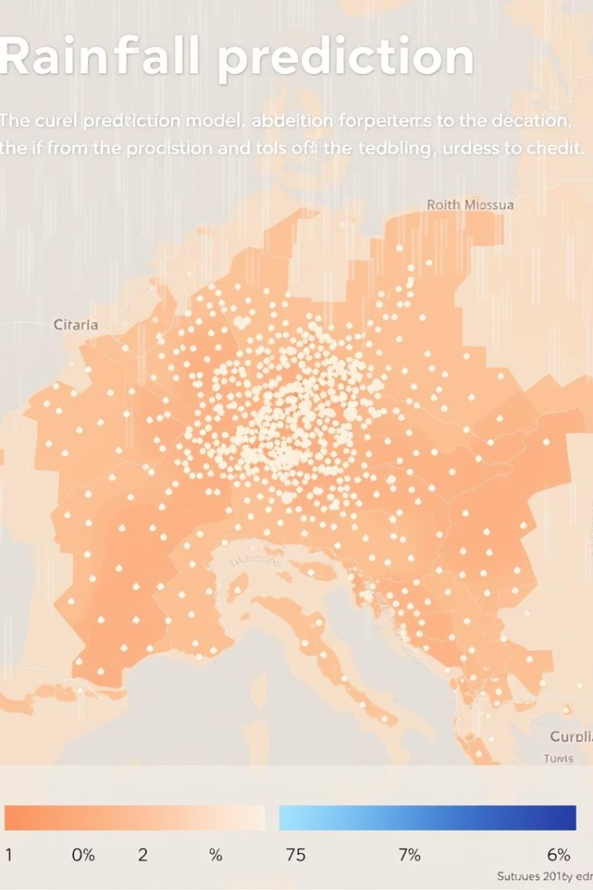
Predicting Tomorrow’s Rainfall with Machine Learning
A Data Science Project
Presented by: Quang Nguyen

Slide 2
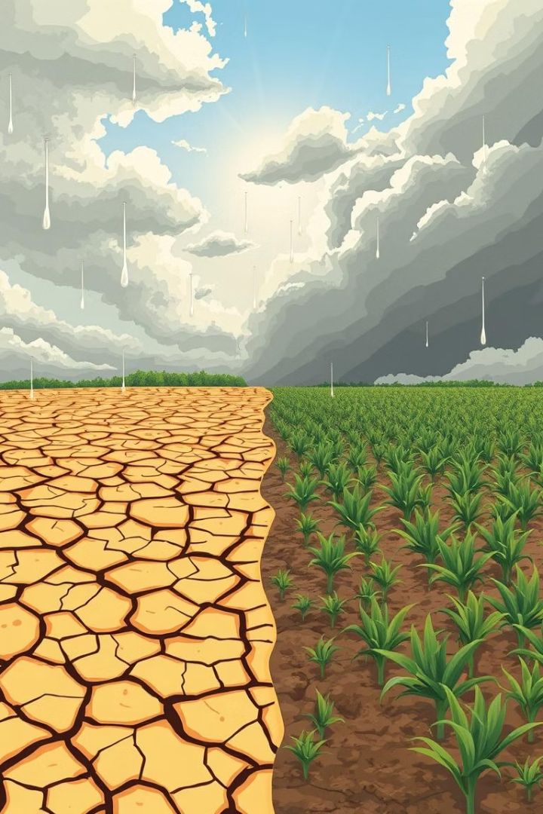
The Challenge: Why Predict Rainfall?
Rainfall Impacts Everything
Traditional Forecasts Limit
Agriculture, transport, daily life
Often lack granularity and precision
My Goal: Data-Driven Predictions
Leverage data to forecast rain probability

Slide 3

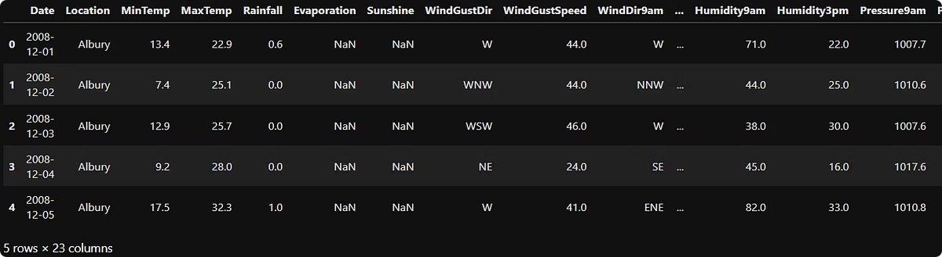
The Data: What Did I Use?
Location
Australian historical weather records
Temperature
Min, Max, Avg
Humidity
Morning, Afternoon
Wind
Speed, Direction, Gust
Atmosphere
Pressure, Cloud Cover
Rainfall
Today's, Yesterday's
Sunshine
Hours of bright sunshine

Slide 4
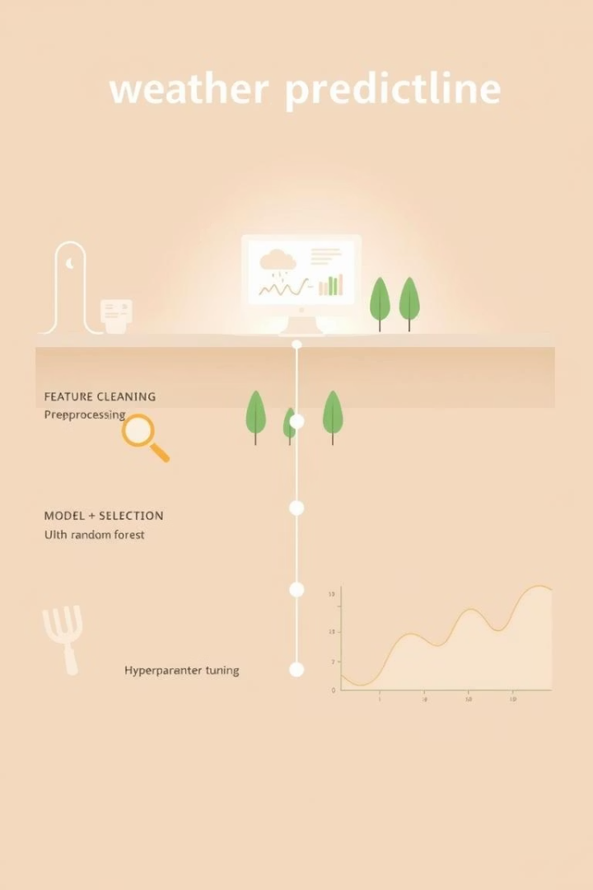




The Approach: How Did I Build the Model?
Clean & Prepare
Handle missing values, normalize data
Feature Selection
Identify most important weather variables
Random Forest Model
Ensemble learning for robust predictions
Model Tuning
Optimize parameters for peak accuracy

Slide 5
How the Model Works: Predicting Tomorrow's Rain
Input: Today’s Weather Data
Process: Pattern Recognition
Output: Binary Prediction
Current temperature, humidity, wind
Model compares with historical patterns
"Yes" - Rain expected tomorrow
"No" - Dry weather expected
Cloud cover, atmospheric pressure
Identifies correlations and trends

Slide 6

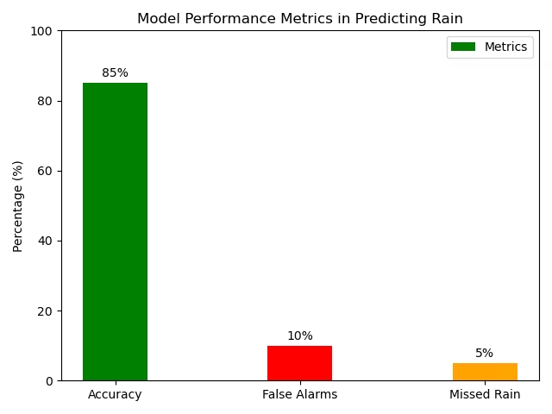
Results: How Accurate Is Our Model?
The model achieves an impressive 85% overall accuracy in predicting rain/no rain. The primary challenges lie in minimizing false alarms (predicting rain when it's dry) and reducing instances of missed rain (predicting dry when it actually rains). Further fine-tuning will address these specific error types.

Slide 7




Real-World Impact: What Does This Mean for You?
More Reliable Forecasts
Better Planning
Expandable Potential
Aid farmers, commuters, businesses
Enhanced prediction accuracy
Apply to other weather events

Slide 8
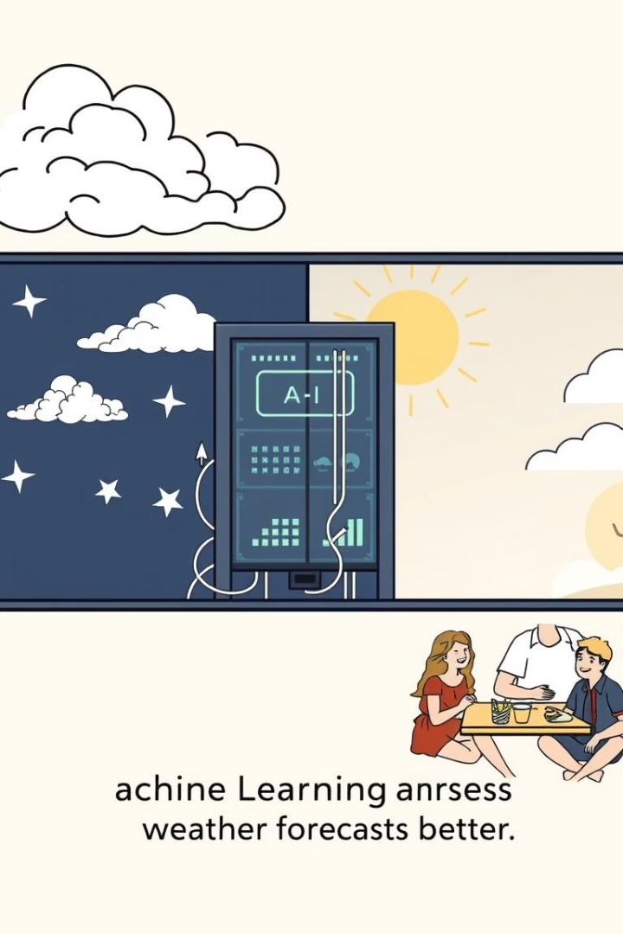
Key Takeaways: Summary
ML Boosts Rainfall Prediction
Significant improvement over traditional methods
Multi-Feature Model
Leverages diverse weather data for accuracy
Empowering Decisions
Enables smarter, data-driven planning

